Slide 1

A Power BI Dashboard Project
TEAM LAPLANDS

Slide 2


INTRODUCTION Problem statement
You are assigned a client by getINNOtized to design and deliver an end-to-end business intelligence solution. Your client has collected transactional data for the year 2019 but hasn’t been able to put it to good use. The client hopes you can analyze the data and put together a report to help them find opportunities to drive more sales and work more efficiently.

Slide 3
Here are some questions that need to be answered:
1. How much money did we make this year?
2. Can we identify any seasonality in the sales?
3. What are our best and worst-selling products?
4. How do sales compare to previous months or weeks?
5. Which cities are our products delivered to most?
6. How do product categories compare in revenue generated and quantities ordered?
7. You are required to show additional details from your findings in your data.
NB: They want products with
unit prices above $99.99 to be labelled high-level
products otherwise they should be basic level.

Slide 4
DATA UNDERSTANDING Procedure
To effectively address the questions at hand, it was imperative for us to delve into a comprehensive understanding of the available data. This involved a meticulous examination of the data sources, an evaluation of the existing features, a consideration of the absent features, an assessment of the data types associated with each feature, and a careful analysis of the desired data types for these features.

Slide 5
CONTINUATION
For this crucial step, we harnessed the power of Python's libraries, including Pandas and Numpy. These tools played a pivotal role in our data exploration process. We employed them to seamlessly load the data and utilized their functions. Specifically, we leveraged pandas' 'info,' 'head,' and 'tail' methods, and combined them with Python functionalities like for loops to ensure a smooth and efficient data understanding experience.

Slide 6
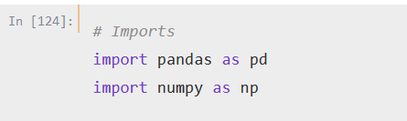
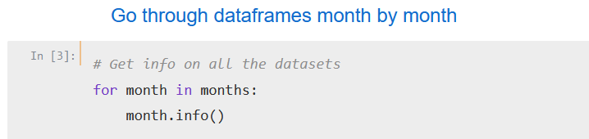
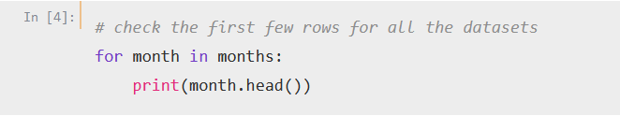
CODE SNIPPETS

Slide 7
EARLY FINDINGS
Calling the info method has revealed that:
1. The feature names were not identical in all the DataFrames. 6 were identical and the other 6 were identical
2. The data types for the features were not the same for all the DataFrames.
Calling the head and tail methods have revealed that:
1. There were some entry mistakes
2. The format of the date feature is different when comparing the first 6 months to the last 6 of the year
3. The month of November and December DataFrames have the same entries
4. The datasets are supposed to be from the
year 2019 but have dates from other years

Slide 8
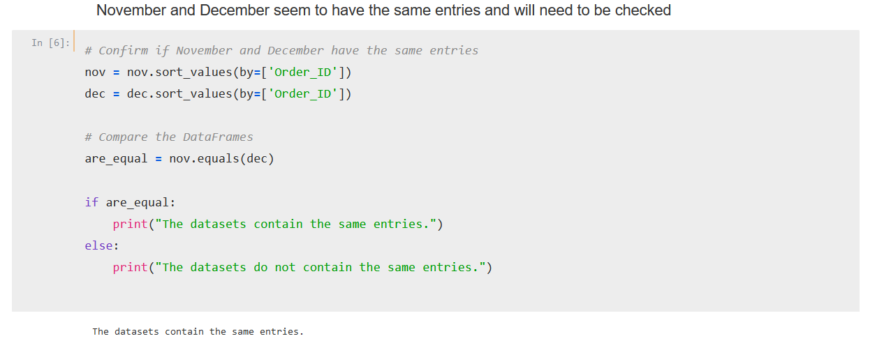
CONTINUATION
5. November and December seem to have the same entries which we checked and confirmed that the datasets contain the same entries.

Slide 9
NEXT STEPS
1. Drop the December dataset
2. Merge dataframes to create 2 dataframes
3. Change feature names to create identical ones in both dataframes
4. Change the data types of all the features to the appropriate ones in both dataframes
5. Use one datetime format for both dataframes
6. Merge the dataframes to create one
7. Change all the dates that are not in 2019 to their corresponding dates in 2019
8. Create new features i.e city, revenue, months, weeks, quarters & product class
9. Proceed to answer client’s questions & further
analysis

Slide 10
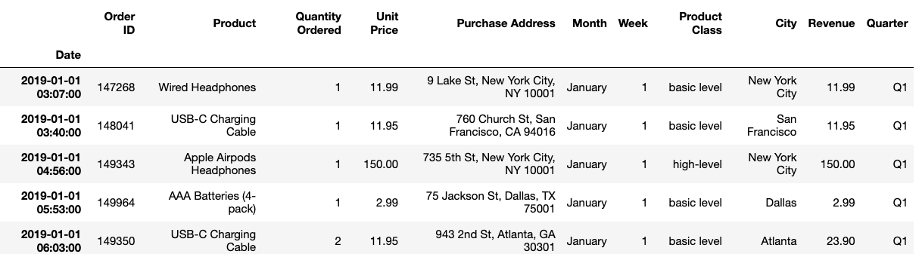
FINAL DATA OUTPUT

Slide 11
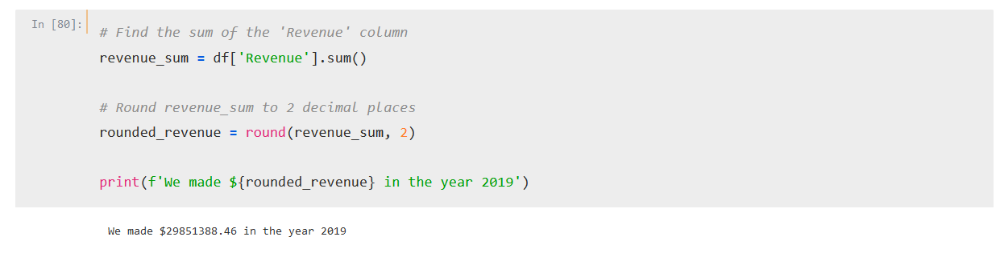
ANSWERING CLIENT QUESTIONS
How much money did we make this year?
The company made $29,851,388.46

Slide 12
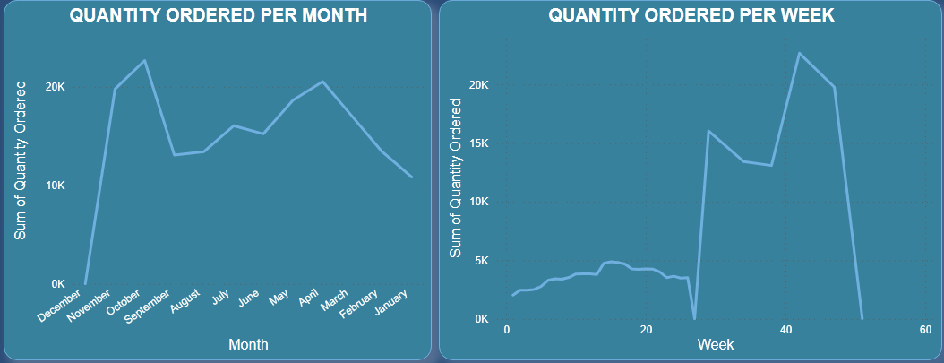
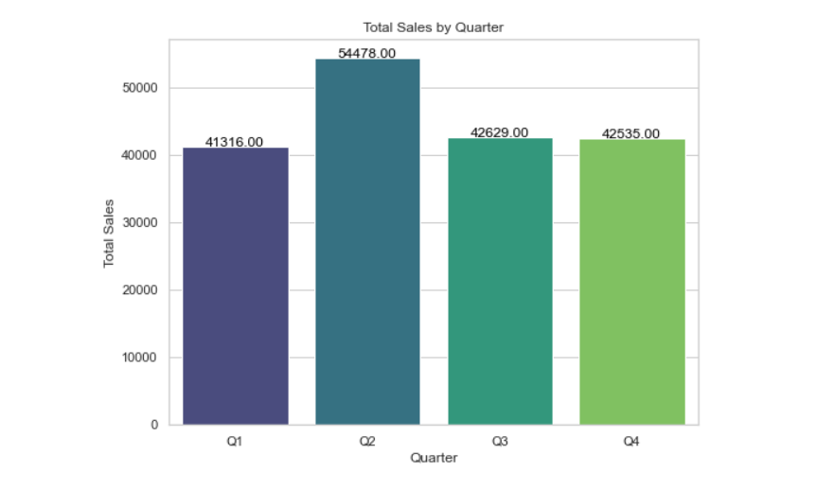
2. Can we identify any seasonality in the sales?

Slide 13
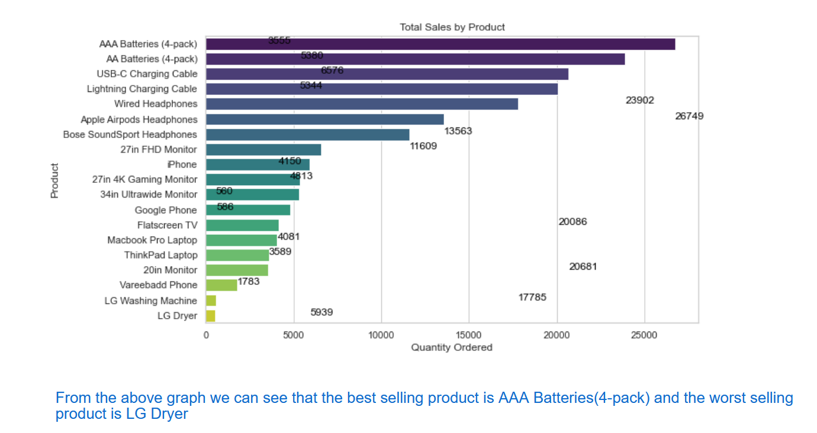
3. What are our best and worst-selling products?

Slide 14
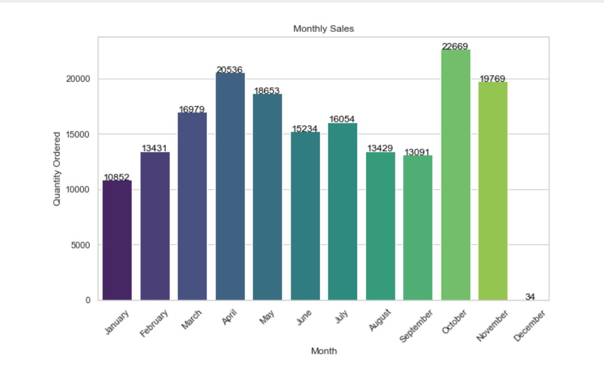
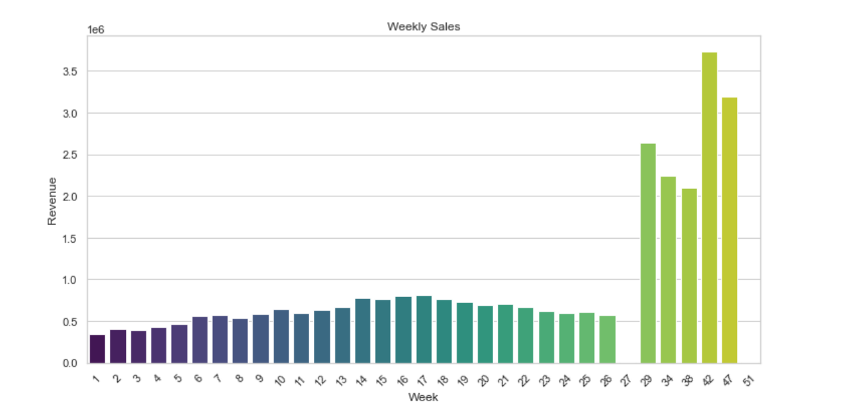
4. How do sales compare to previous months or weeks?

Slide 15
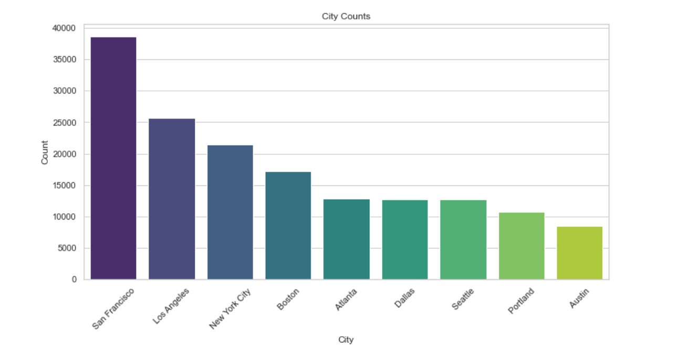
5. Which cities are our products delivered to most?

Slide 16
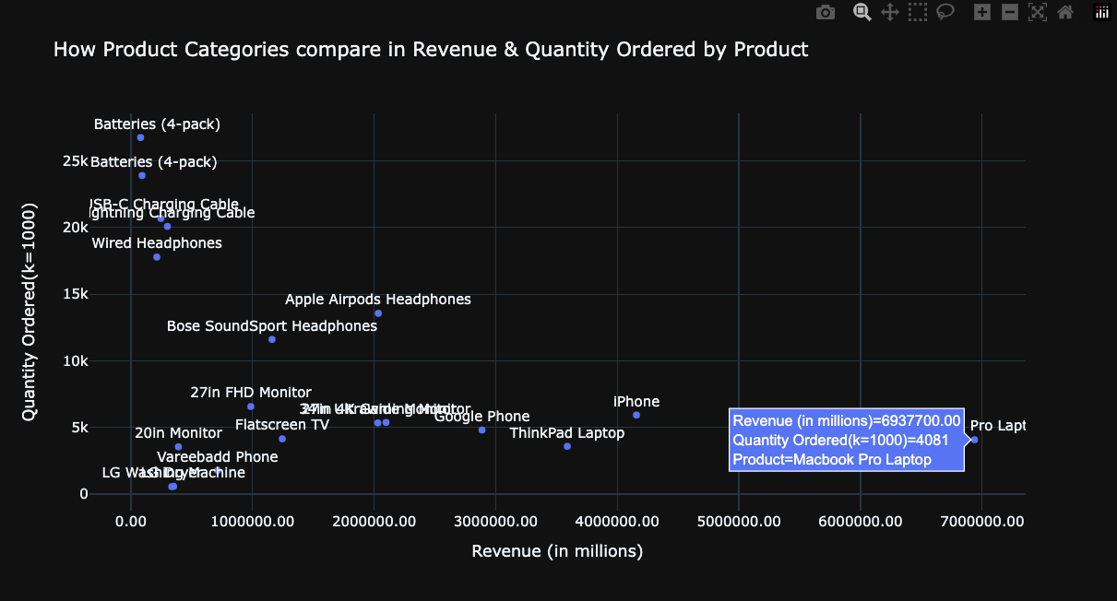
6. How do product categories compare in revenue generated and quantities ordered?

Slide 17
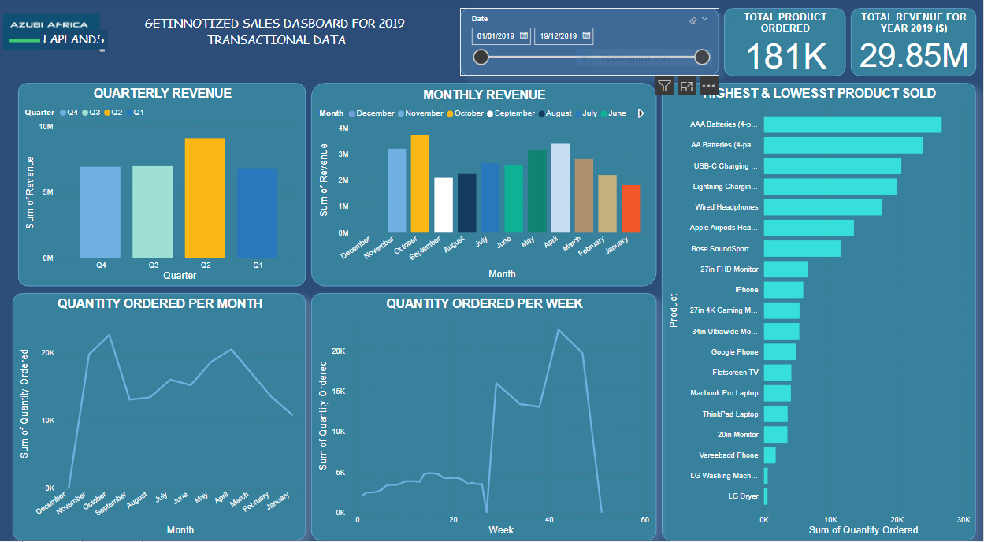
FINAL DASHBOARD

Slide 18
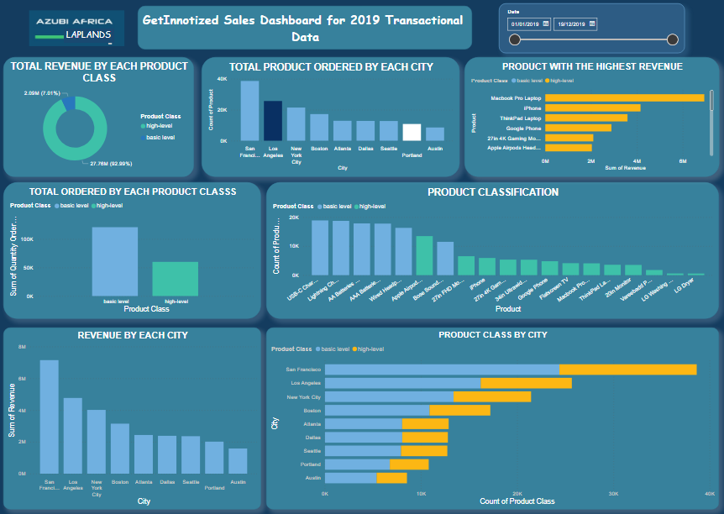

Slide 19
THANK YOU!!!

